Slide 2
Unit 2: DevOps Basics with Virtualization (5hrs)
Basics of Virtualization: Definition, Types, and Hierarchy of Virtualizations
Learn Virtualization: Manual and Automatic. OS Environments: Linux, MacOS, and Windows
Bash Scripting. Basics of Scripting
Variables, Conditions, Loops, etc.
Automating day-to-day Admin Tasks

Slide 3
Virtualization
Virtualization is creating a virtual version of something rather than a physical one.
In computing, software simulates hardware functionality, allowing multiple operating systems or applications to run on a single physical machine simultaneously.
Virtualization is foundational in DevOps and cloud computing because it enables efficient resource use, isolation, scalability, and automation.
This practice maximizes a physical machine’s capacity by distributing its resources between multiple users and environments.

Slide 4
Virtualization
Virtualization is a technology that creates a virtual (software-based) version of computing resources, such as servers, storage, networks, and desktops.
It abstracts physical hardware resources into virtual resources that can be easily managed, modified, or scaled according to application needs.

Slide 5
Virtualization
Each VM has an operating system and acts as an independent computer even though it runs on a portion of the physical device.
A virtual machine mimics all components of a computer, including:
CPU.
RAM.
Storage.
Networks.
With virtualization, a piece of hardware can host numerous VM configurations simultaneously without performance issues.

Slide 6
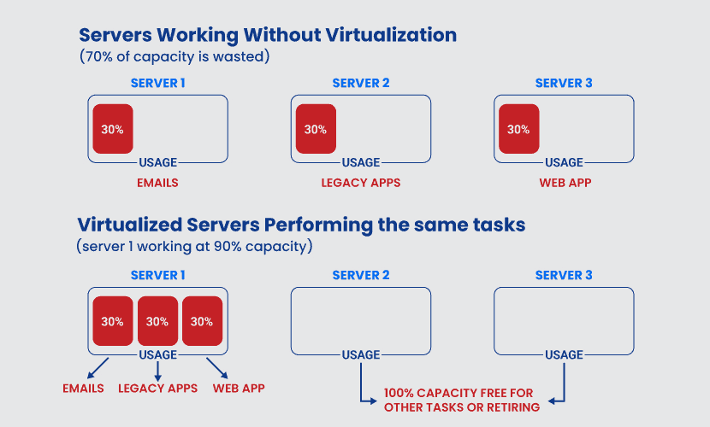
Virtualization

Slide 7
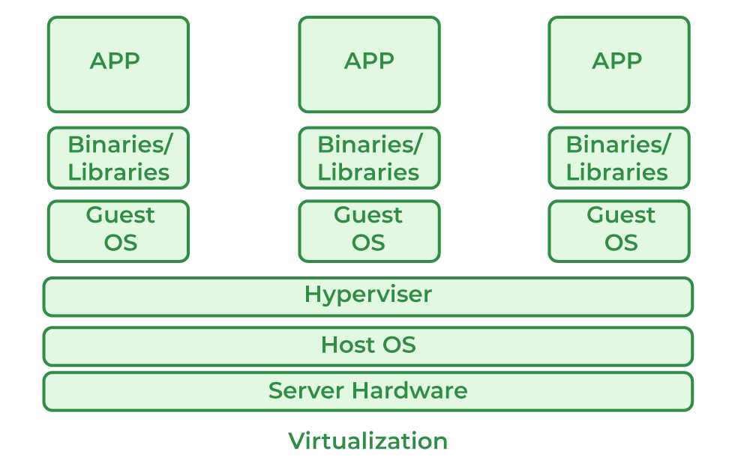
Virtualization

Slide 8
Benefits of Virtualization
Resource Efficiency: Maximizes resource utilization by allowing multiple virtual machines (VMs) to run on a single hardware system.
Isolation: Each VM operates independently, improving security and stability and minimizing risks of conflicts.
Scalability: Quickly scales resources up or down based on demand.
Flexibility: Enables quick provisioning and deployment of applications and environments.

Slide 9
Types of Virtualization
Virtualization comes in various types, each serving a different purpose within IT and DevOps environments:
Server Virtualization
Desktop Virtualization
Application Virtualization
Network Virtualization
Storage Virtualization
Data Virtualization
OS Virtualization

Slide 10
Server Virtualization
Definition: Server virtualization divides a physical server into multiple isolated virtual servers, known as Virtual Machines (VMs).
Use Cases: Commonly used to optimize physical server usage, reduce costs, and run different operating systems and applications on a single physical machine.
Examples of Tools: VMware, Hyper-V, KVM.

Slide 11
Desktop Virtualization
Definition: Desktop virtualization allows the creation of virtual desktops that users can access remotely on any device.
Use Cases: Provides secure and flexible desktop access, especially useful for remote work and IT troubleshooting.
Examples of Tools: VMware Horizon, Citrix Virtual Apps and Desktops.

Slide 12
Application Virtualization
Definition: Application virtualization separates an application from the underlying OS, allowing it to run in an isolated environment.
Use Cases: Helps avoid compatibility issues by packaging applications for use on different OS versions or configurations.
Examples of Tools: Citrix XenApp, Microsoft App-V.

Slide 13
Network Virtualization
Definition: Network virtualization abstracts network resources like switches, routers, and firewalls into virtual network components.
Use Cases: Enhances network flexibility, security, and scalability in cloud and data center environments.
Examples of Tools: VMware NSX, Cisco ACI, Open vSwitch.

Slide 14
Storage Virtualization
Definition: Storage virtualization pools physical storage from multiple devices into a single virtual storage unit.
Use Cases: Simplifies storage management, improves scalability, and optimizes performance.
Examples of Tools: IBM Spectrum Virtualize, NetApp ONTAP.

Slide 15
Data Virtualization
Definition: Data virtualization aggregates data from different sources without physically moving it.
Use Cases: Enables real-time data access and analysis across different storage systems or databases.
Examples of Tools: Denodo, Red Hat Data Virtualization.

Slide 16
OS Virtualization
Definition: OS virtualization creates isolated user-space instances called containers that run on a single OS kernel.
Use Cases: Used in DevOps for lightweight, efficient deployment of applications without the need for full VMs.
Examples of Tools: Docker, LXC, Kubernetes (for orchestrating containers).

Slide 17
Hierarchy of Virtualizations
The hierarchy of virtualization refers to the different layers or levels at which virtualization can occur in an IT infrastructure. Here is a breakdown of the virtualization hierarchy:
Hardware-Level Virtualization
OS-Level Virtualization
Application-Level Virtualization

Slide 18
Hardware-Level Virtualization
Virtualization starts at the hardware level, where physical resources like CPU, memory, and storage are virtualized.
Hardware-level virtualization allows multiple virtual instances (VMs) to share hardware resources effectively.
Example Technologies: Intel VT-x, AMD-V, Virtual Machine Monitor (VMM).

Slide 19
OS-Level Virtualization
OS-level virtualization allows multiple isolated user-space instances (containers) to run on the same OS kernel.
It’s more lightweight than full hardware virtualization because containers share the host OS kernel, making it efficient for applications with lower resource needs.
Example Technologies: Docker, LXC.

Slide 20
Application-Level Virtualization
At the application level, virtualization isolates applications from the underlying OS and other applications, creating a virtual environment specifically for the application.
This type of virtualization is often used to avoid compatibility issues and ensure applications run consistently across environments.
Example Technologies: Citrix XenApp, Microsoft App-V.

Slide 21
Hypervisors in Virtualization
A hypervisor, also known as a Virtual Machine Monitor (VMM), is software that creates and manages VMs on a host machine.
There are two types of hypervisors:
Type 1 (Bare-Metal Hypervisor)
Type 2 (Hosted Hypervisor)

Slide 22
Hypervisors in Virtualization
Type 1 (Bare-Metal Hypervisor): Runs directly on the physical hardware, offering high performance and direct hardware access.
Examples: VMware ESXi, Microsoft Hyper-V, KVM.
Type 2 (Hosted Hypervisor): Runs on an operating system as an application, making it less performant but more flexible for development environments.
Examples: VMware Workstation, VirtualBox.

Slide 23
Learn Virtualization
Allows developers and IT professionals to simulate multiple computing environments on a single physical machine.
There are two main methods of virtualization setup
Manual
Automatic

Slide 24
Manual Virtualization
Manual virtualization involves creating virtual machines (VMs) or containers by configuring settings individually for each environment.
This approach is more hands-on and gives full control over configuration but requires detailed knowledge of the virtualization platform.
This is more time-consuming.

Slide 25
Manual Virtualization
Steps for Manual Virtualization
Install Hypervisor: Start by installing a hypervisor, such as VMware, VirtualBox, or KVM.
Create a Virtual Machine: Define parameters like CPU allocation, RAM, disk space, and network settings.
Install Guest OS: Manually install the OS on each virtual machine.
Customize Environment: Set up applications, dependencies, and configurations manually.

Slide 26
Manual Virtualization
Advantages of Manual Virtualization
Full control over every aspect of the virtual machine.
Ideal for learning and experimenting with detailed configurations.
Ensures deep understanding of VM setup and resource allocation.

Slide 27
Manual Virtualization
Disadvantages of Manual Virtualization
Time-consuming, especially when creating multiple VMs.
Prone to human error, which can affect configuration consistency.
Less efficient for large-scale environments where quick provisioning is required.

Slide 28
Automatic Virtualization
Automatic virtualization uses scripts and automation tools to create and manage virtual environments.
With automation, environments can be provisioned quickly and consistently, making it ideal for large-scale setups and environments requiring frequent updates.

Slide 29
Automatic Virtualization
Automation Tools for Virtualization
Vagrant: Used to automate VM creation using predefined configurations.
Ansible, Puppet, Chef: Automate configuration management and provisioning of VMs and containers.
Docker Compose: Automates the setup of containerized applications using Docker.

Slide 30
Automatic Virtualization
Steps for Automatic Virtualization
Define Configuration: Create a configuration file specifying parameters like OS, CPU, memory, and storage (e.g., a Vagrantfile for Vagrant or a Dockerfile for Docker).
Run Automation Command: Use a command to initiate VM or container creation, which automatically follows the specified configurations.
Provision Environment: Apply scripts for installing applications, dependencies, and network settings.

Slide 31
Automatic Virtualization
Advantages of Automatic Virtualization
Quick and consistent environment setup.
Reduces time and effort in configuration for large deployments.
Easily replicable, making it ideal for testing and scaling.

Slide 32
Automatic Virtualization
Disadvantages of Automatic Virtualization
Less control over specific details compared to manual setup.
Requires knowledge of automation tools.
Initial setup of automation scripts can be complex for beginners.

Slide 33
OS Environments
Virtualization is widely supported across Linux, macOS, and Windows operating systems, each with specific tools and configurations.
Each OS (Linux, macOS, Windows) has tailored virtualization tools, ensuring flexibility across development, testing, and production environments.

Slide 34
Linux Virtualization
Popular Tools: KVM (Kernel-based Virtual Machine), Docker, LXC, VirtualBox.
Strengths: Linux offers native support for KVM, enabling highly efficient virtualization. Docker containers are also widely used for lightweight, isolated environments.
Common Use Cases: Server virtualization, containerized microservices, DevOps CI/CD pipelines.

Slide 35
macOS Virtualization
Popular Tools: VMware Fusion, Parallels Desktop, Docker (for macOS).
Strengths: macOS supports virtualization for testing macOS applications, with Docker being widely used for containerized environments.
Common Use Cases: Development environments for cross-platform applications, testing iOS and macOS software, lightweight containerized development setups.

Slide 36
Windows Virtualization
Popular Tools: Hyper-V, VMware Workstation, VirtualBox, Docker for Windows.
Strengths: Windows provides native support for Hyper-V, enabling easy VM creation for various Windows environments. Docker for Windows allows containerized applications.
Common Use Cases: Enterprise applications, testing Windows Server configurations, DevOps automation with PowerShell, and Dockerized environments.

Slide 37
Comparison of OS Environments
Feature | Manual Virtualization | Automatic Virtualization
Setup Time | Longer setup, more detailed | Fast, especially for multiple environments
Consistency | Prone to configuration inconsistencies | Highly consistent across multiple setups
Control | High control over every setting | Limited to pre-defined configurations
Scaling | Challenging to scale quickly | Quick, easily repeatable for scaling
Best For | Small projects, learning environments | Large projects, CI/CD pipelines, test automation

Slide 38
Virtualization
Choosing between manual and automatic virtualization depends on project requirements, scale, and the level of control needed.
Manual virtualization provides greater control, ideal for learning or small projects, while automatic virtualization ensures consistency and speed, making it suitable for large-scale and automated deployments.

Slide 39
End of Lecture 5

Slide 40
BASH SCRIPTING
BASICS OF SCRIPTING

